Slide 1
Project 3 - Einstein Vision
Jesulona Akinyele
Krunal Bhatt
Guided by: Prof. Nitin J. Sanket

Slide 2
Phase 1
Detic, YoloPv2, ZoeDepth

Slide 3
Phase 1 requirements
Lanes: Show the different kinds of lanes on the road,
Vehicles: Identify all cars
Pedestrians: Locate pedestrians and display them
Traffic lights: Indicate the traffic signals and it’s color
Road signs: Primarily indicate stop signs

Slide 4
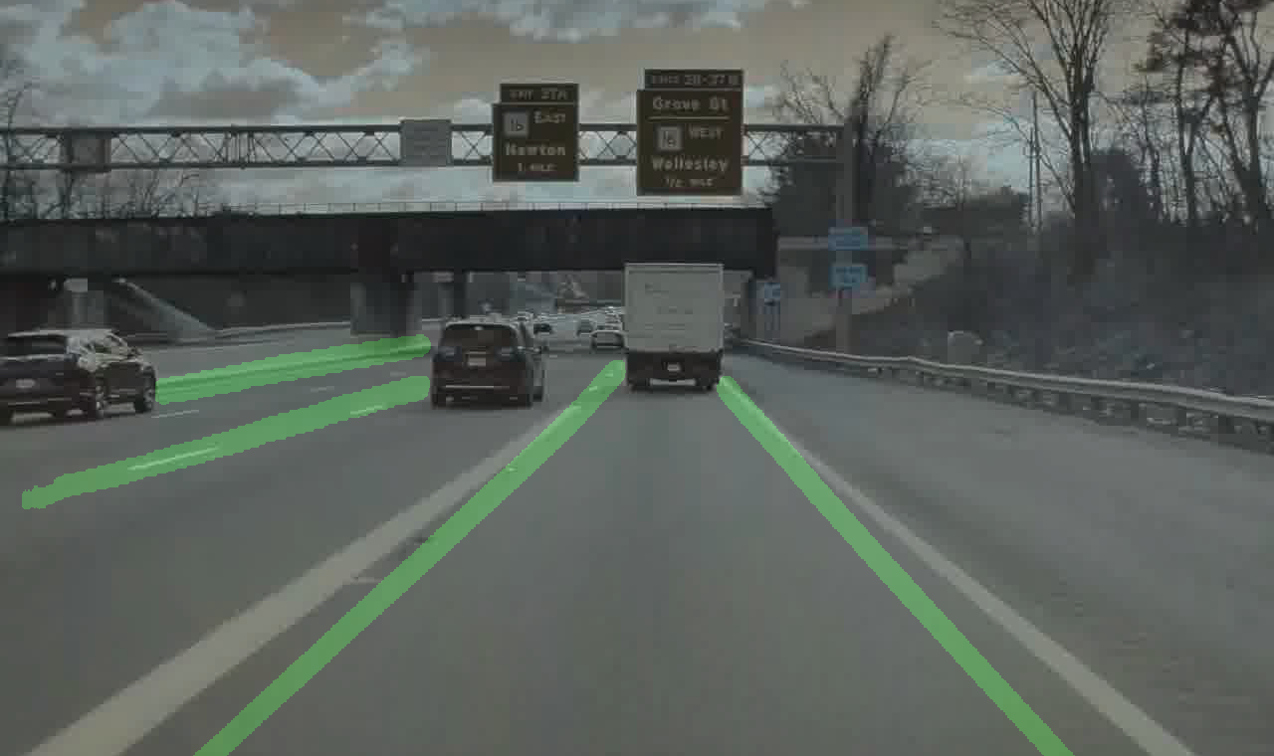
Phase 1 Outcomes
Lane detection with YolopV2.
No differentiation

Slide 5
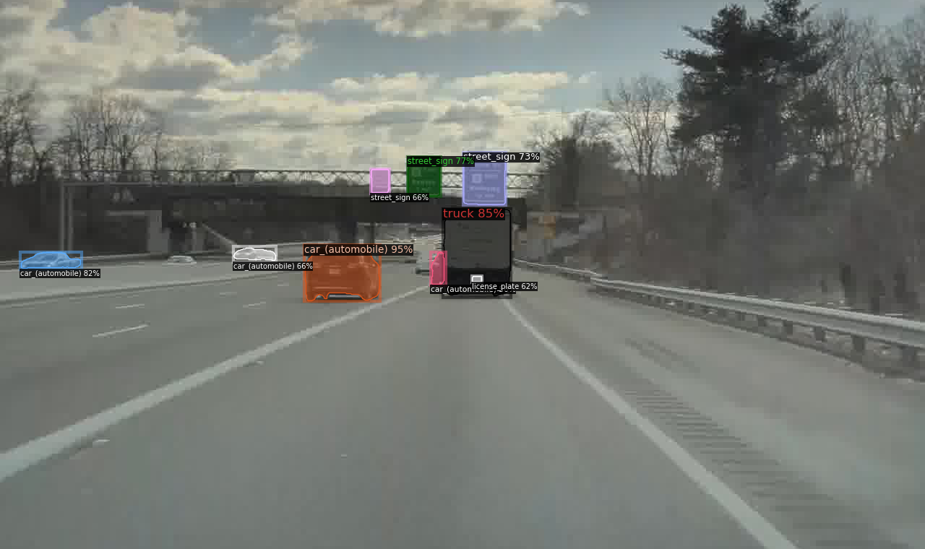
Phase 1 Outcomes
Vehicle Detection with Detic
Different Vehicle types

Slide 6
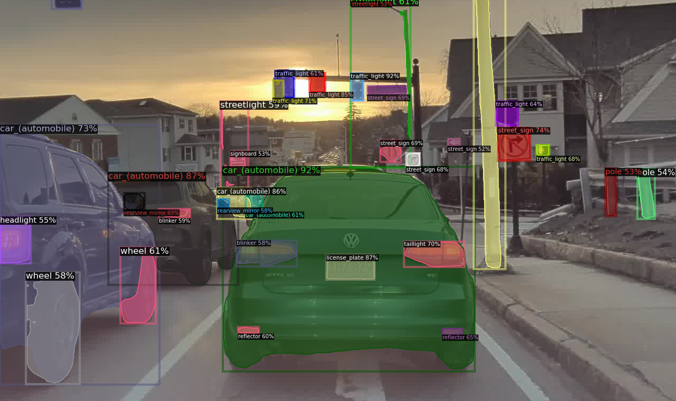
Phase 1 Outcomes
Traffic Light Detection
Street sign detection

Slide 7
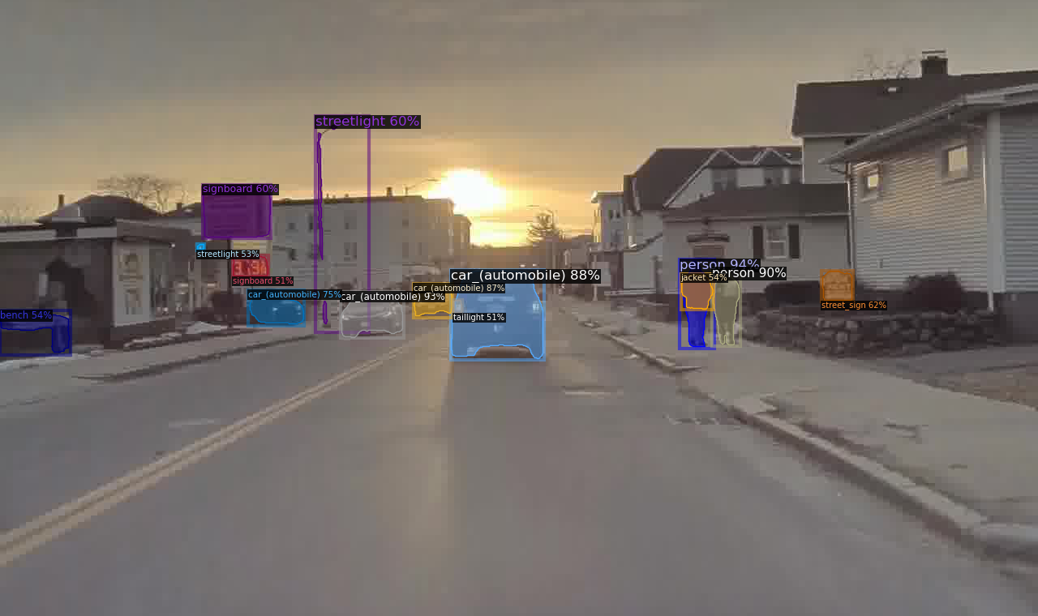
Phase 1 Outcomes
Pedestrian Detection using Detic

Slide 8
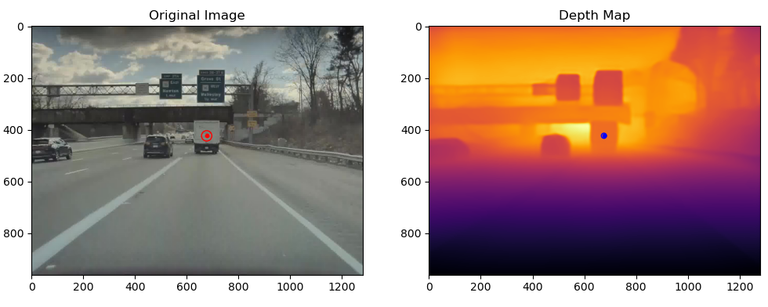
Phase 1 Issues
Implimented Zoe Depth
Issues with reprojection
Issues with Traffic light color

Slide 9
Phase 2
Yolo3D

Slide 10
Phase 2 requirements
Phase 2 emphasis on Pose estimation
Vehicles: Identify orientation of different vehicles
Traffic lights: Classify arrows on the traffic lights
Road signs: Ground arrows and speed limit signs
Objects: Dustbins, traffic poles, traffic cones and traffic cylinders
Pedestrian pose: Pedestrian pose each frame

Slide 11
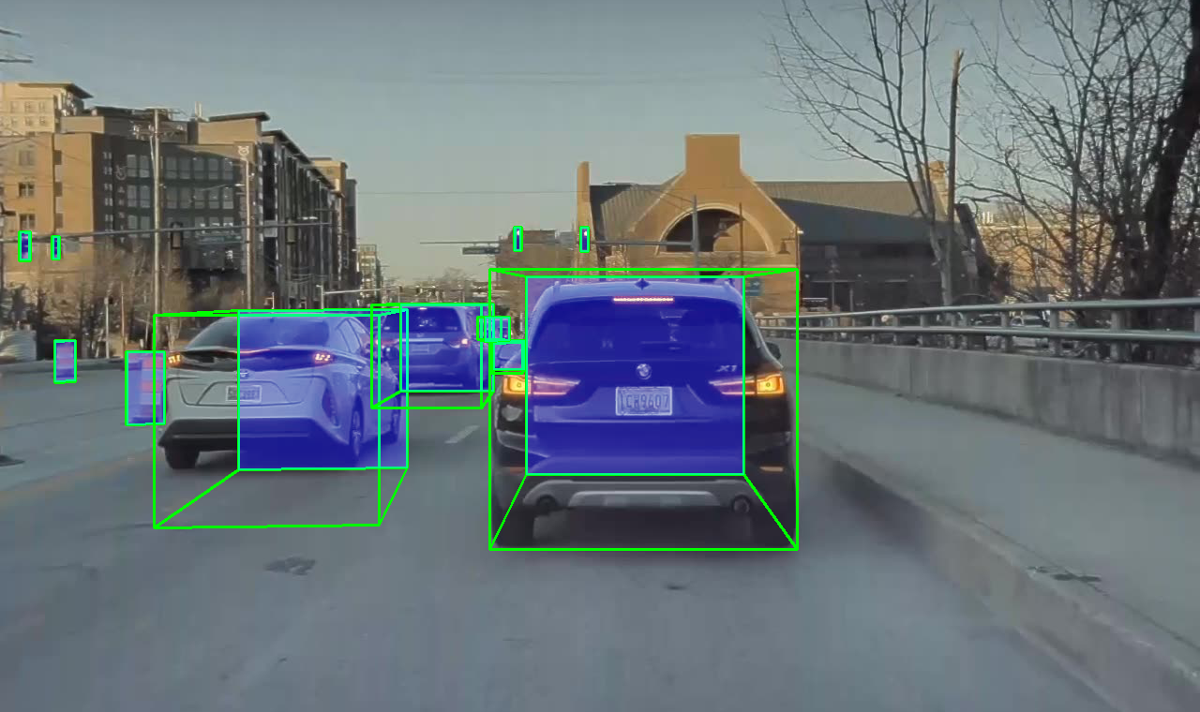
Phase 2 Outcomes
Orientation of all objects of interest
Vehicles, traffic lights, objects and pedestrians

Slide 12
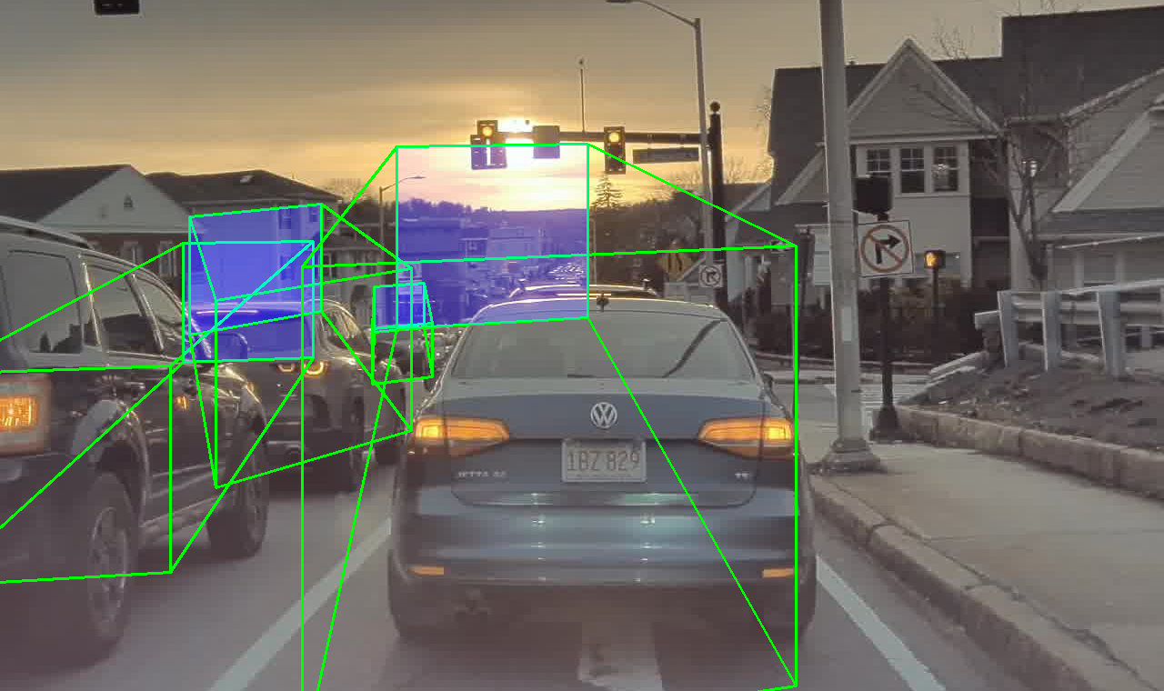
Phase 2 Challenges
Fixed Yolo3D reprojection
Estimated scaling factor for reprojection
Not perfect
No traffic light color or arrow

Slide 13
Phase 3
Detic-YOLO3D, maskRCNN

Slide 14
Phase 3 requirements
Phase 3 emphasis on fine tuning
Break lights and indicators of the other vehicle
Parked and Moving Vehicle

Slide 15
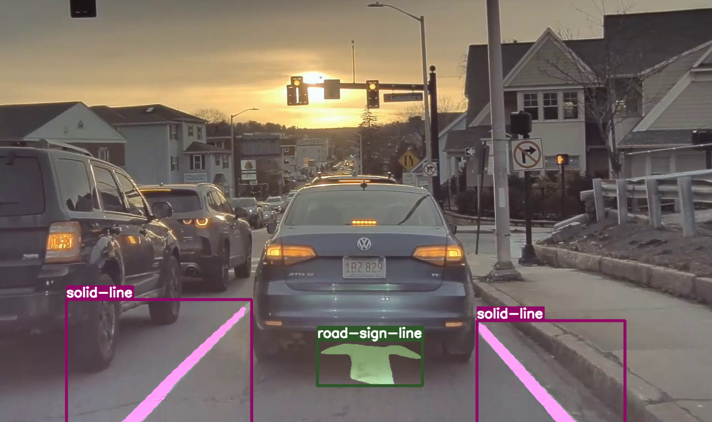
Phase 3 Outcomes
Improved object positioning
2D detection phase of YOLO3D replaced with Detic
Brake light monitoring
MaskRCNN for lane detection & street markings

Slide 16
Phase 3 Challenges
No indicator distinction
No time for Optical flow (very close)

Slide 17
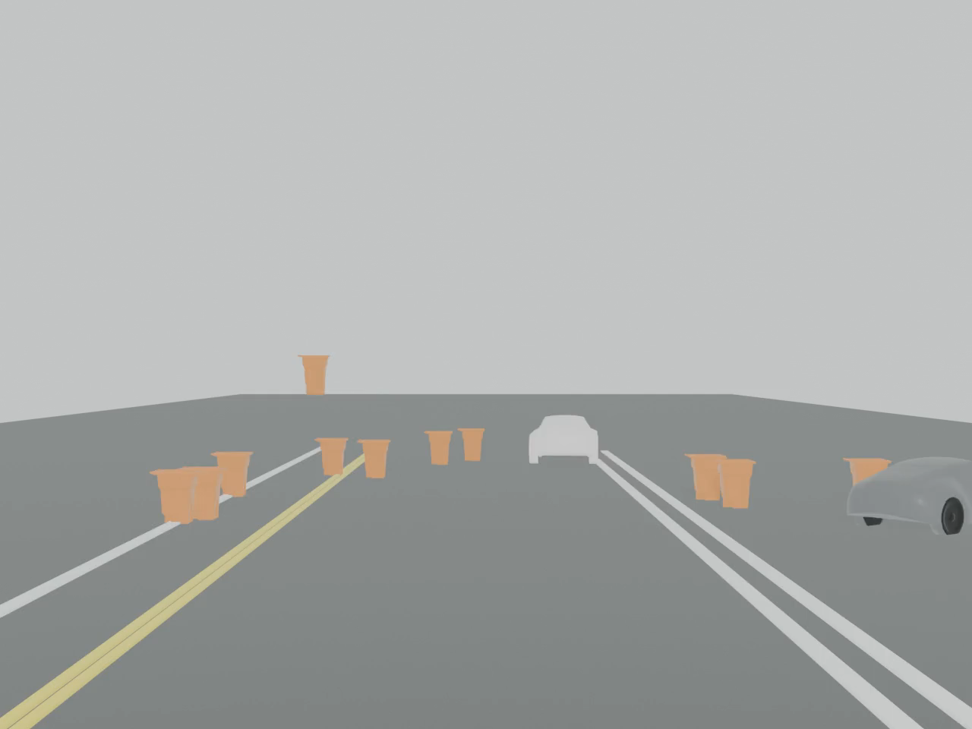
Phase 3 Output

